Slide 1


Year 2
Autumn 1 Enrichment

Slide 2
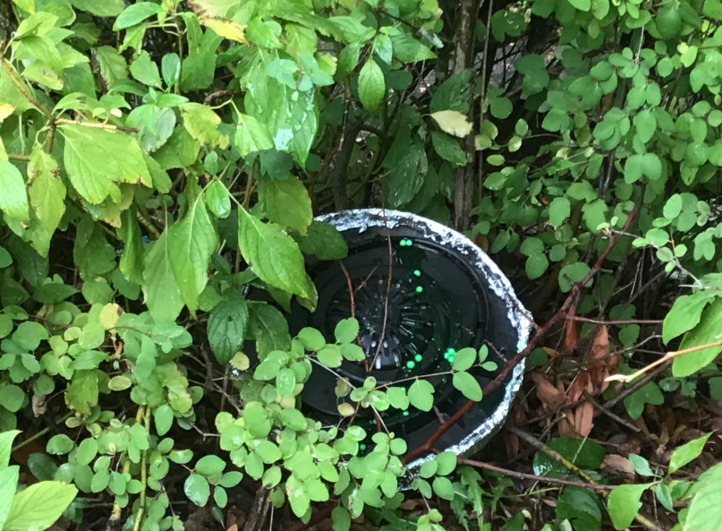
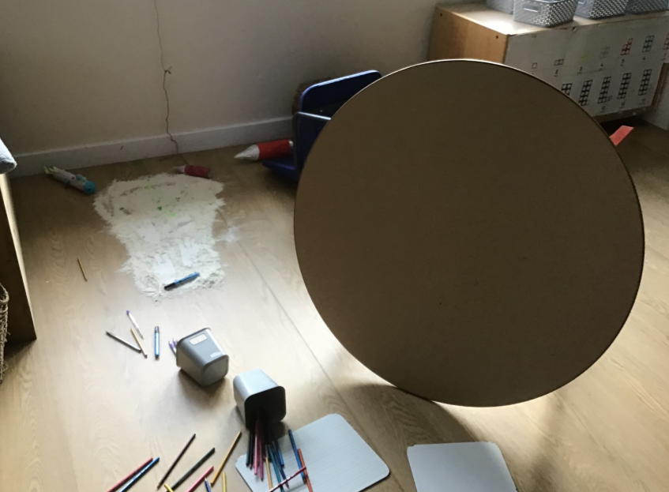
Aliens have landed!!!!
As part of our immersion stage in writing the children found an alien space craft that had crash landed onto the playground. The children had a discussion about what could have been in the spacecraft and linked their learning to Beegu that they learned about in year 1. The children later wrote their own alien descriptions. All children where engaged and this helped to provide a context for the story they were learning.

Slide 3
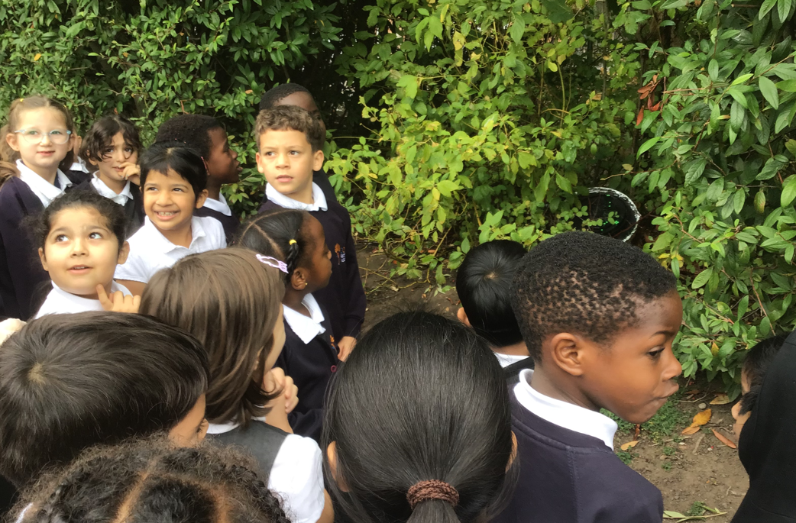

Slide 4
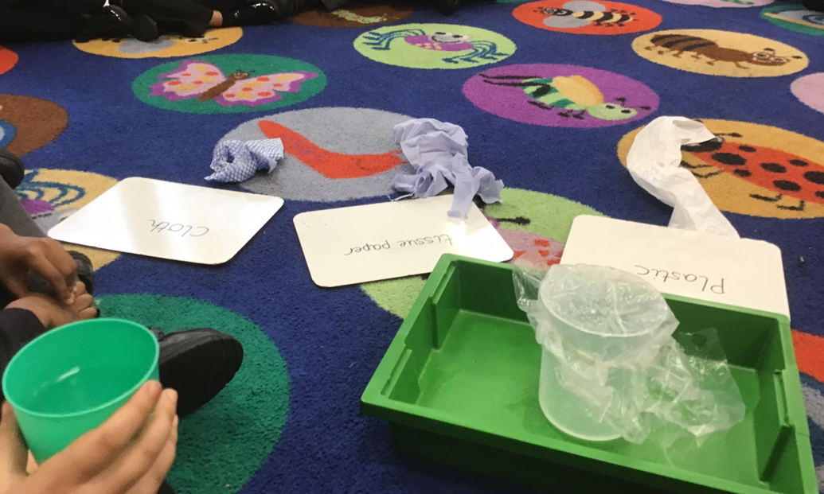
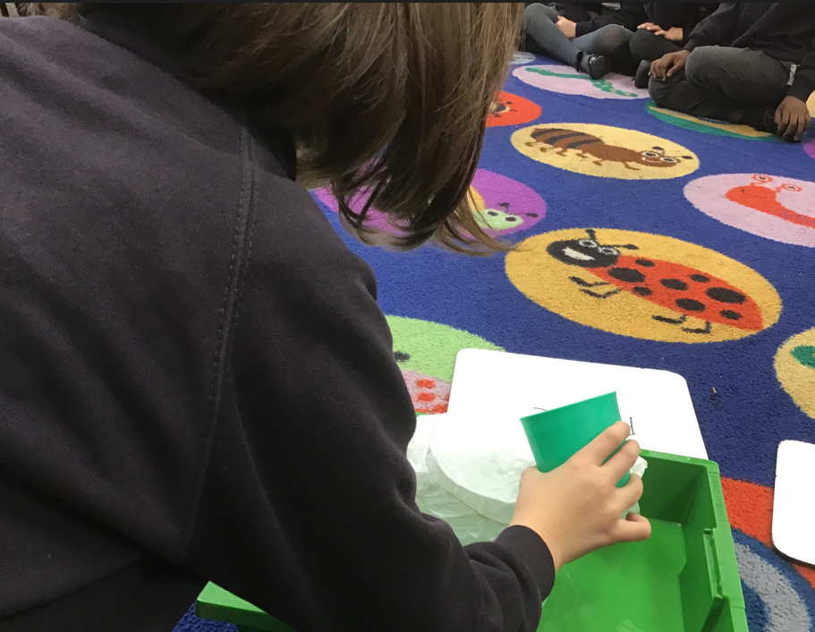
Science: waterproof experiment
As part of our science topic we researched which materials were the most waterproof. We then recorded our findings in our books.

Slide 5
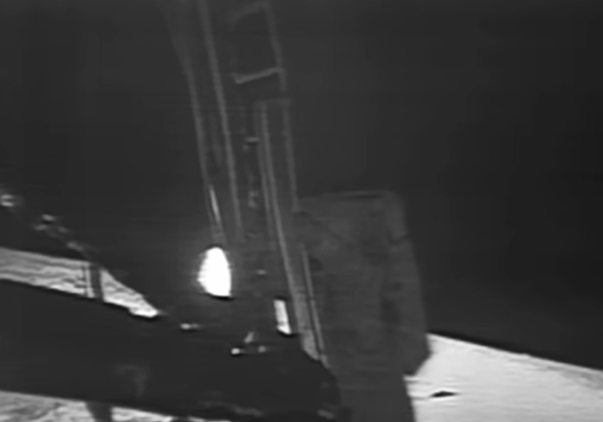
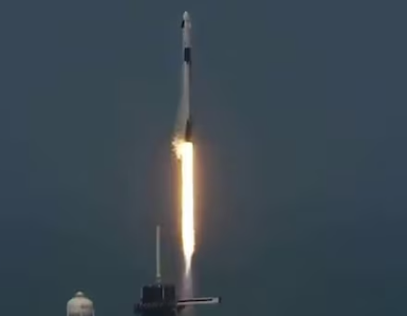
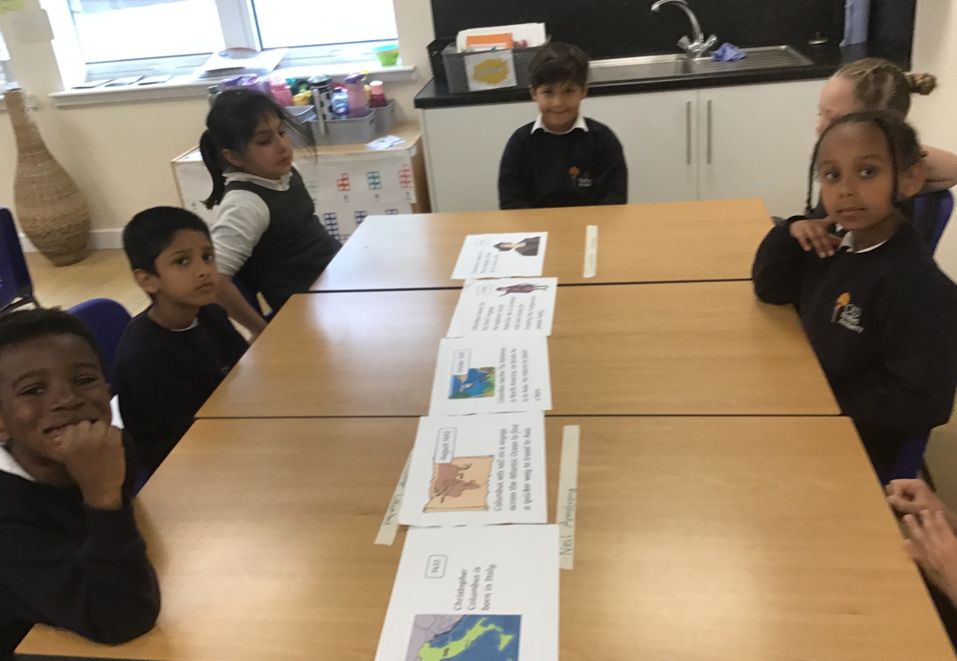
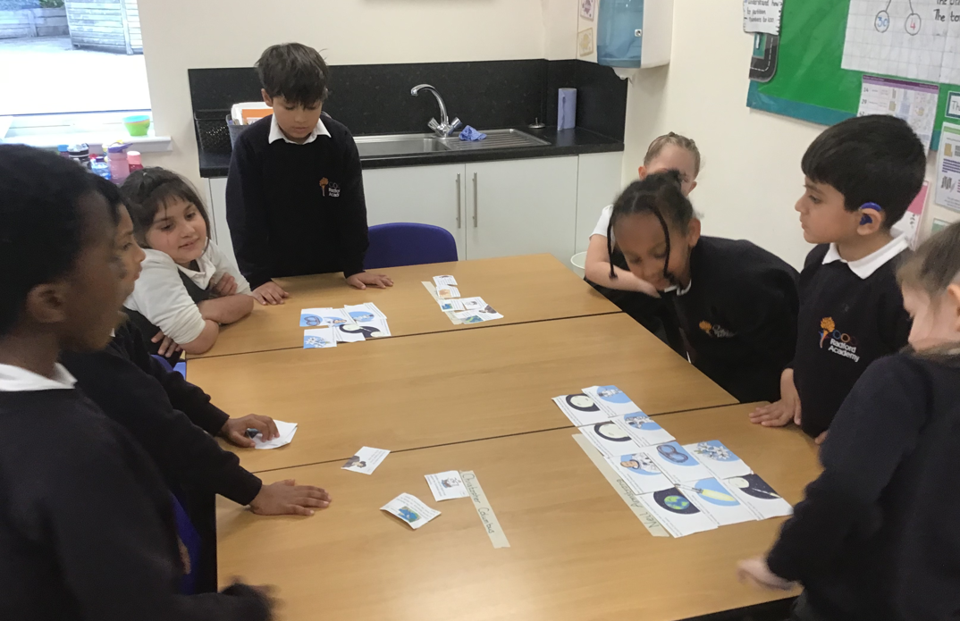
History
In History we watched videos of the moon landings in 1969 and today and we also worked together to create a timeline for Christopher Columbus.

Slide 6
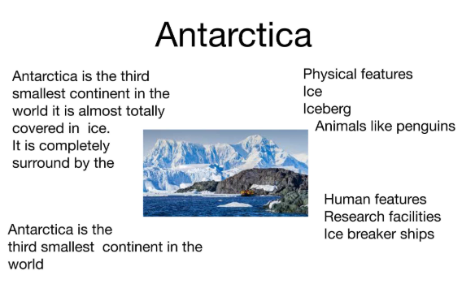
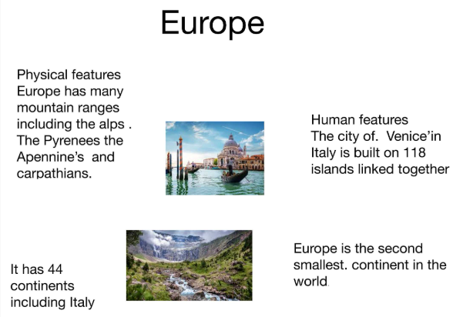
Geography
In Geography we used the pages app to present what we had learned about the continents. We had to type information as well as getting pictures from the internet

Slide 7
Creative Homework

Slide 8
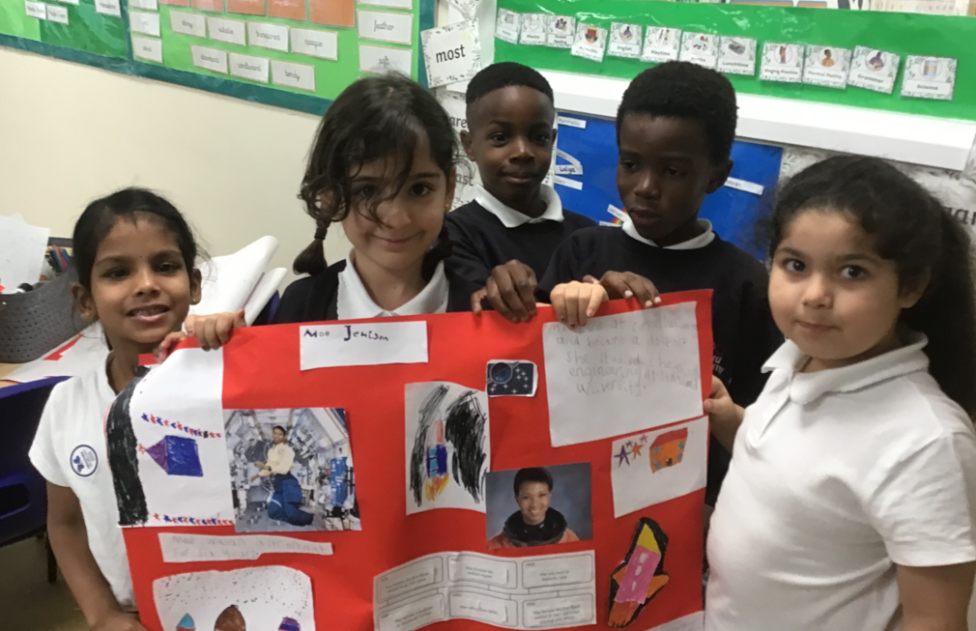
Black History presentations
As part of Black History month the children researched Mae Jemision the first American Black woman to go to space. They worked in groups to make posters and then presented to the class and some children presented in assembly.

Slide 9
