Slide 1


Year 1
Autumn 1 Enrichment

Slide 2
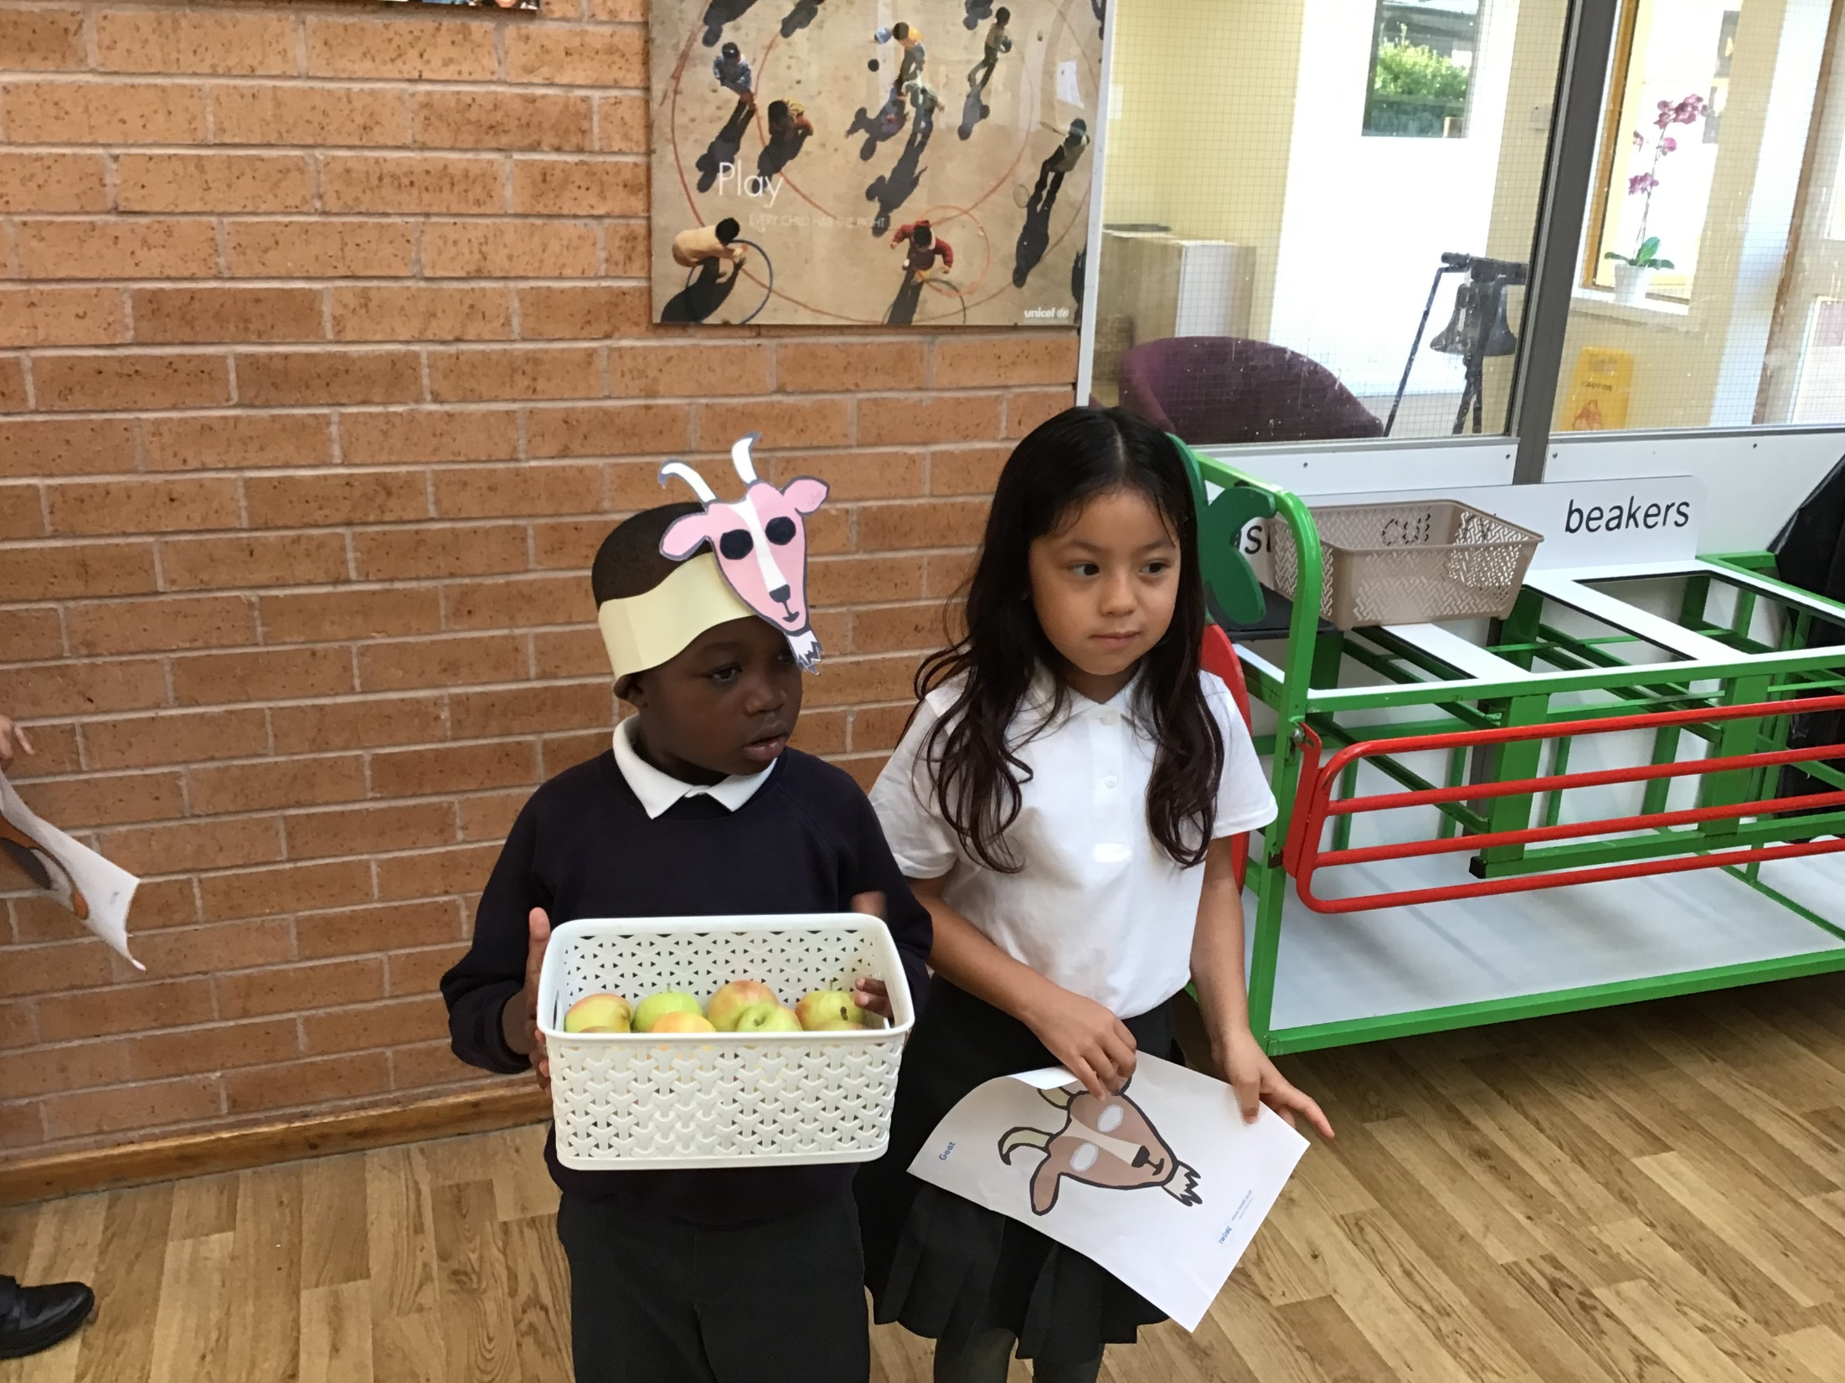
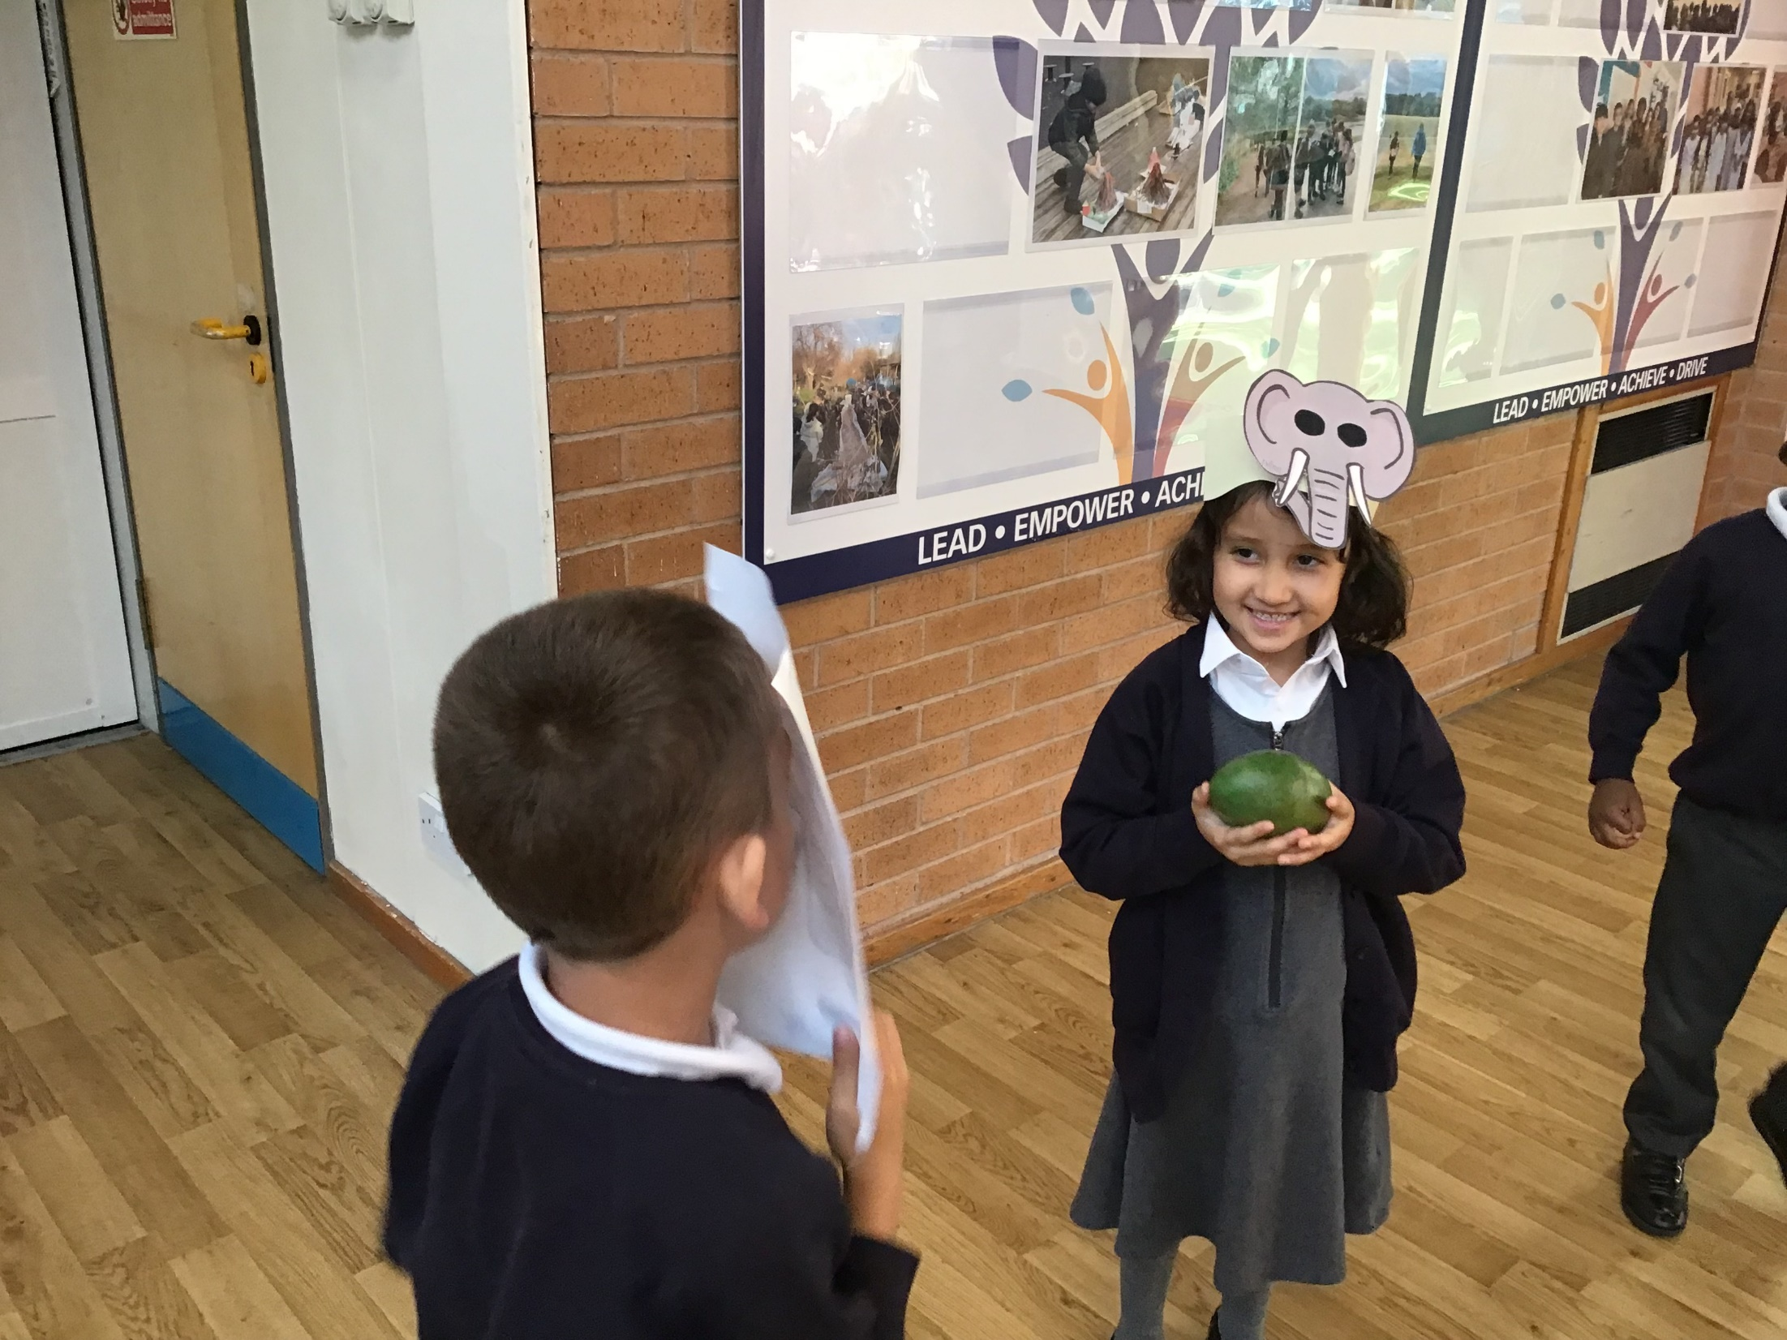
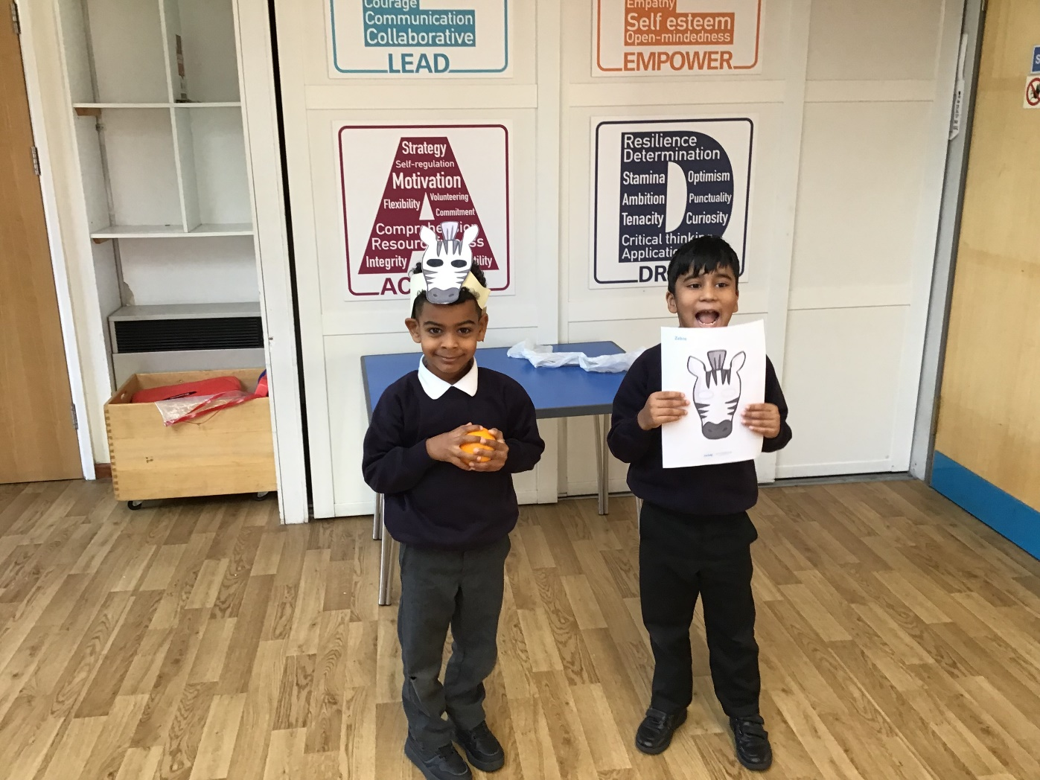
As part of our immersion stage for literacy, children had the chance to re-enact their focus text ‘Handa’s Surprise’. They learnt about all the different names for the animals and fruits within the story.

Slide 3
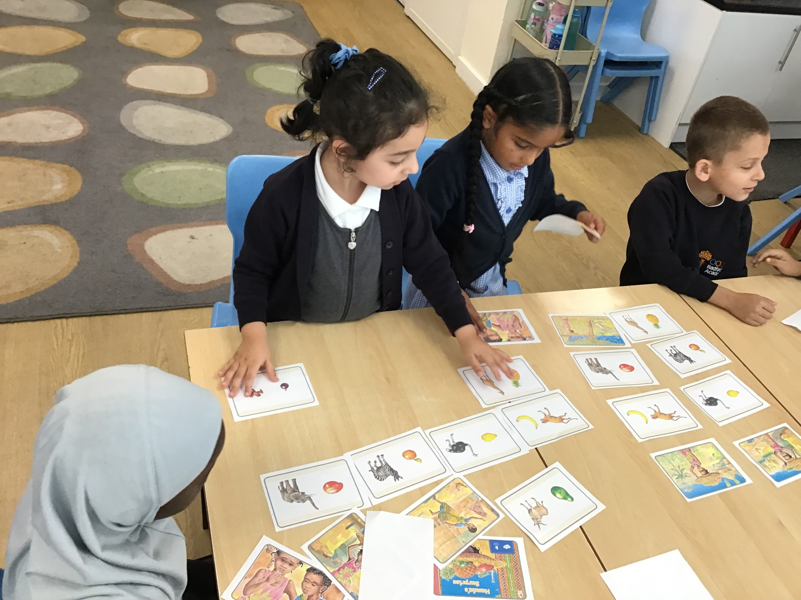
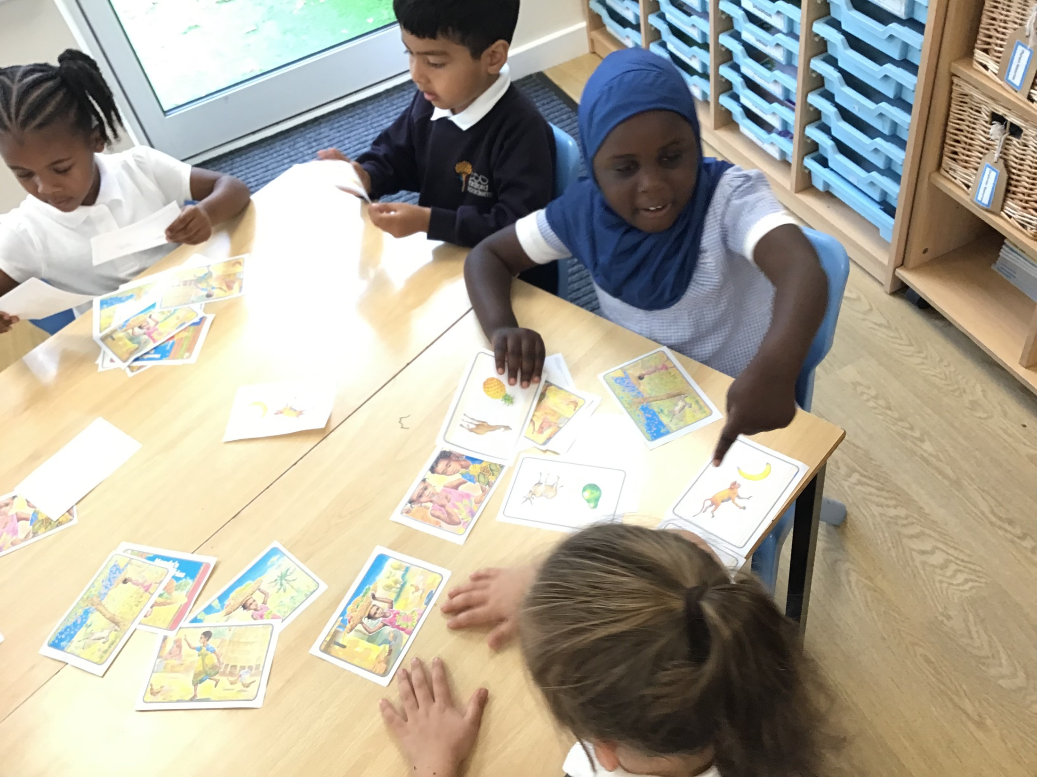
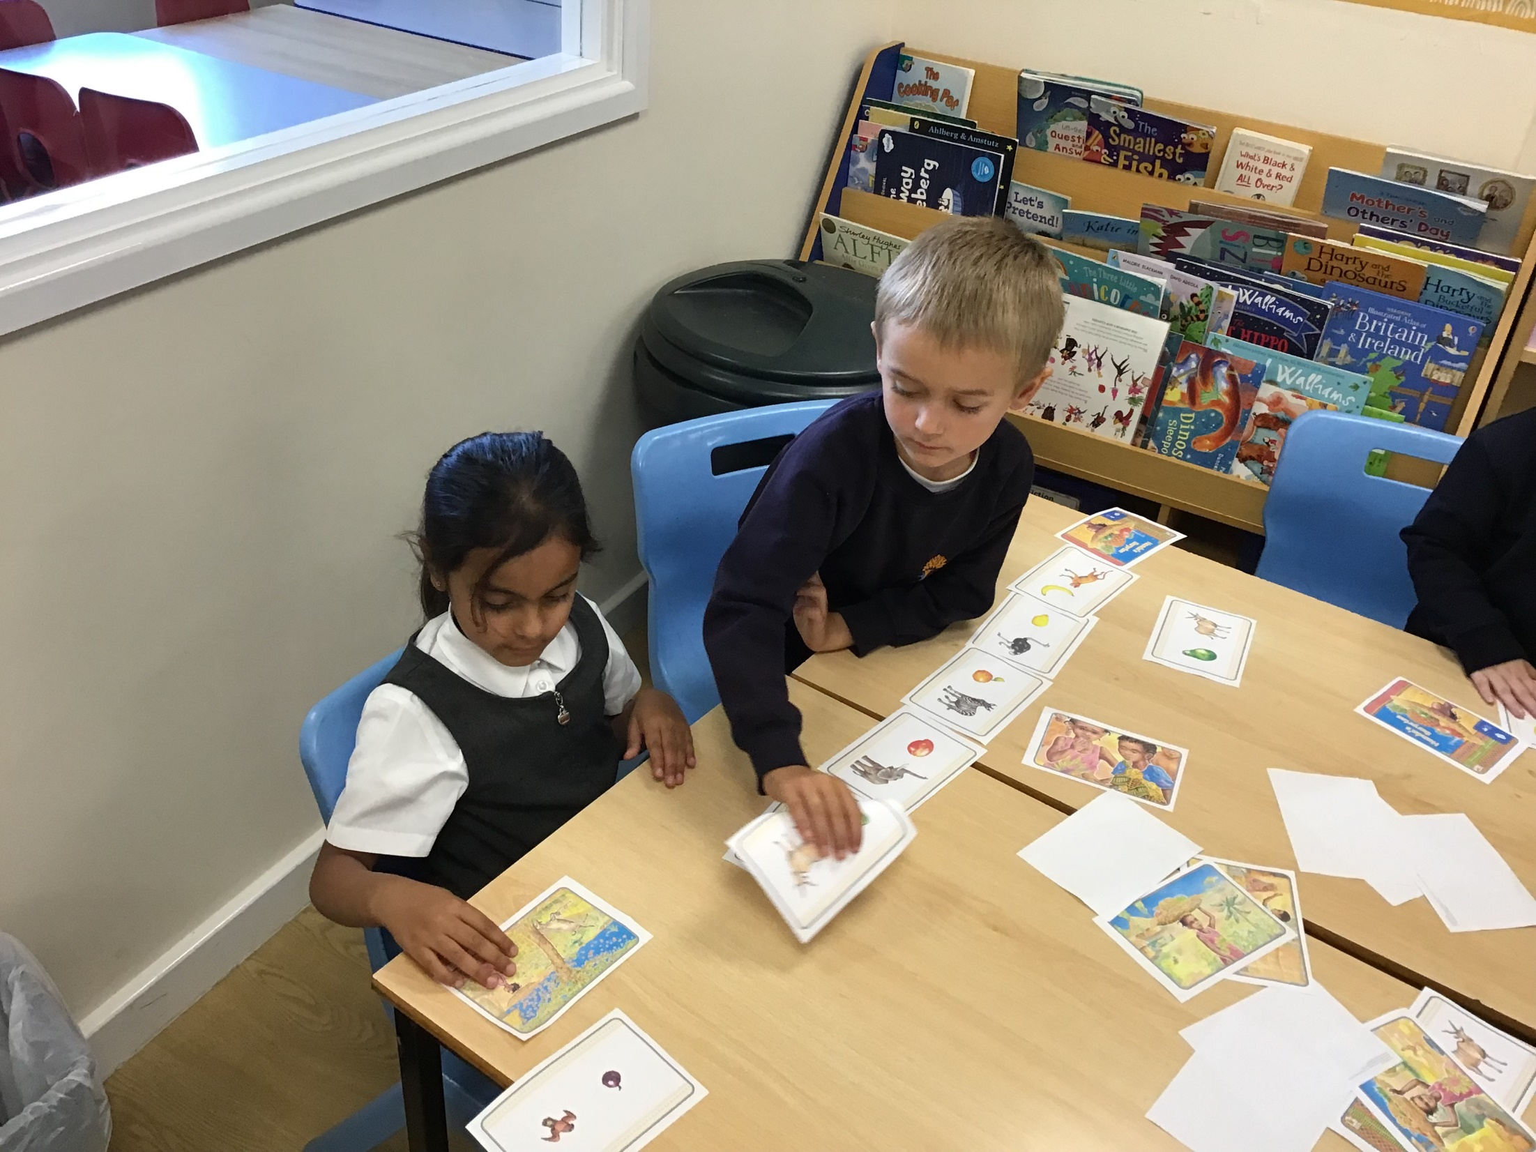
During the immersion week, children get to know and understand their focus text. To ensure they have understood the story, they were introduced how to sequence a story through the use of pictures.

Slide 4
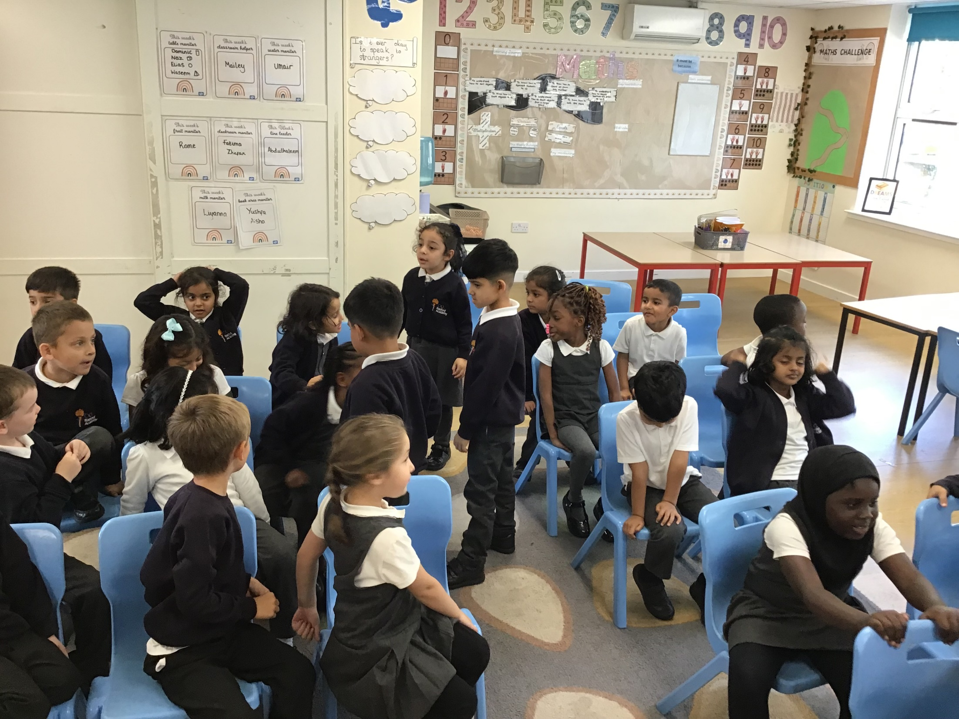
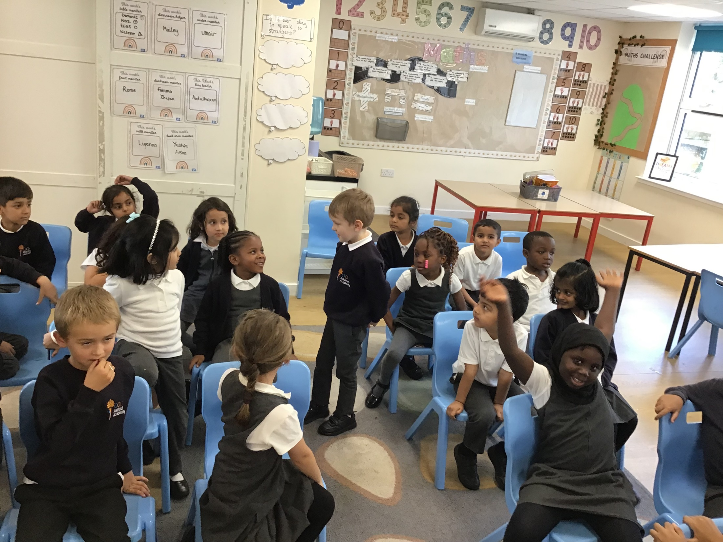
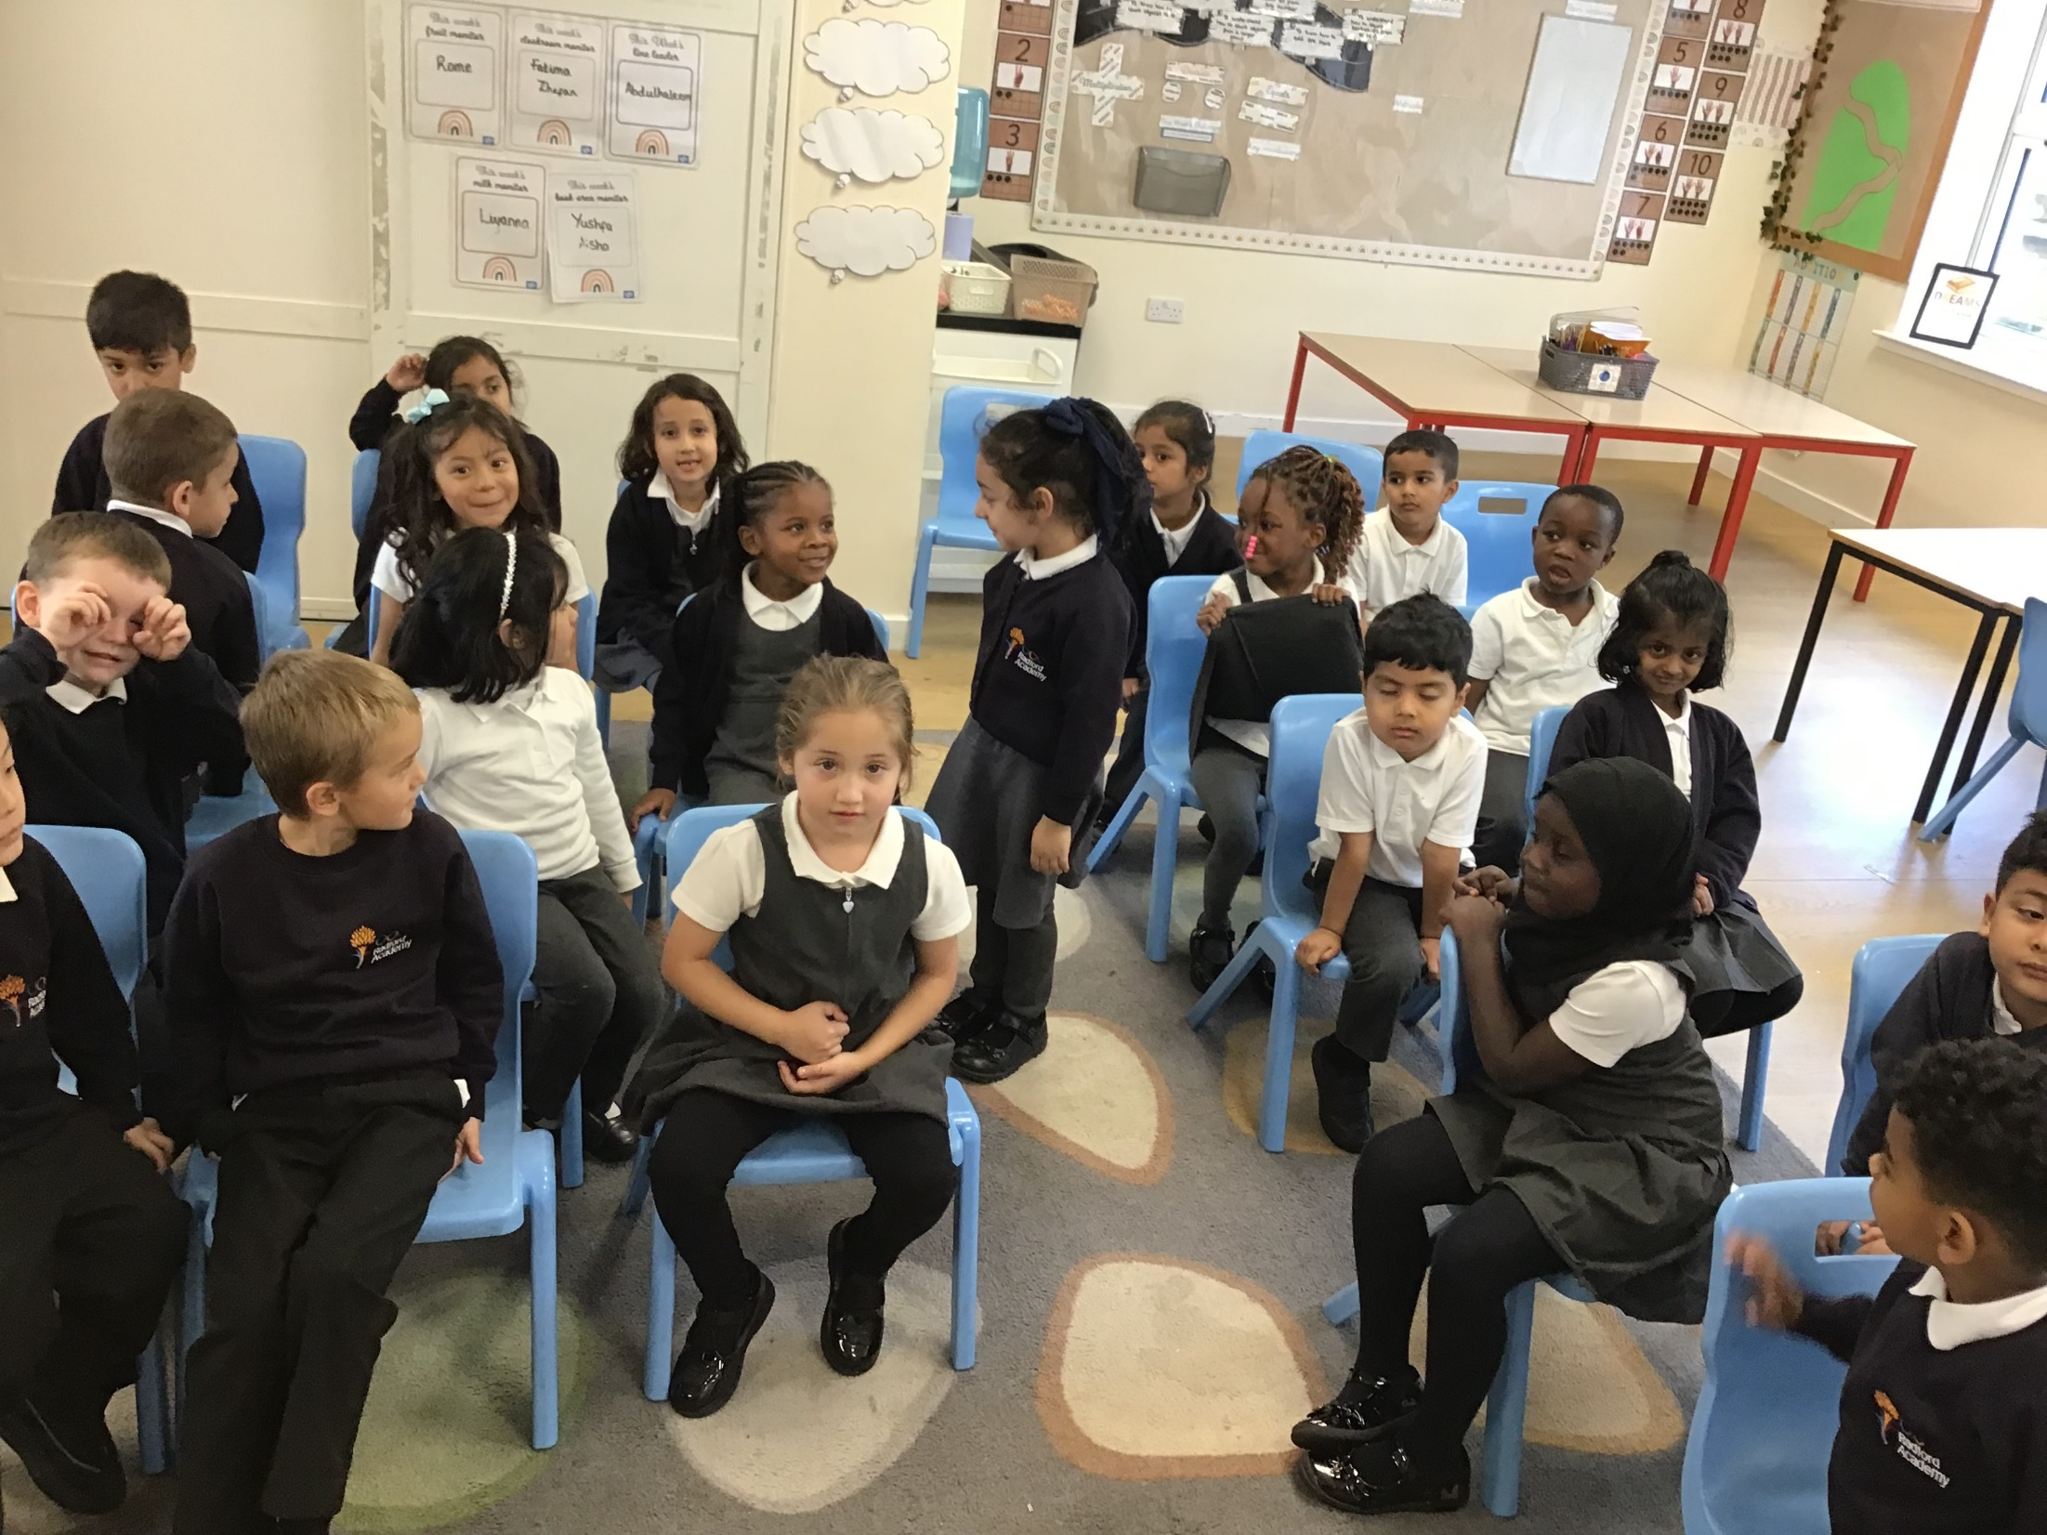
As part of Class 1’s History topic on Rosa Parks, they made an enquiry about Rosa parks life; understanding about segregation, diversity and equality. They had the opportunity to listen to and watch the story and then to re-enact the story. They recognised that Rosa Parks was treated unfairly, and that it is important that we are all treated the same.

Slide 5
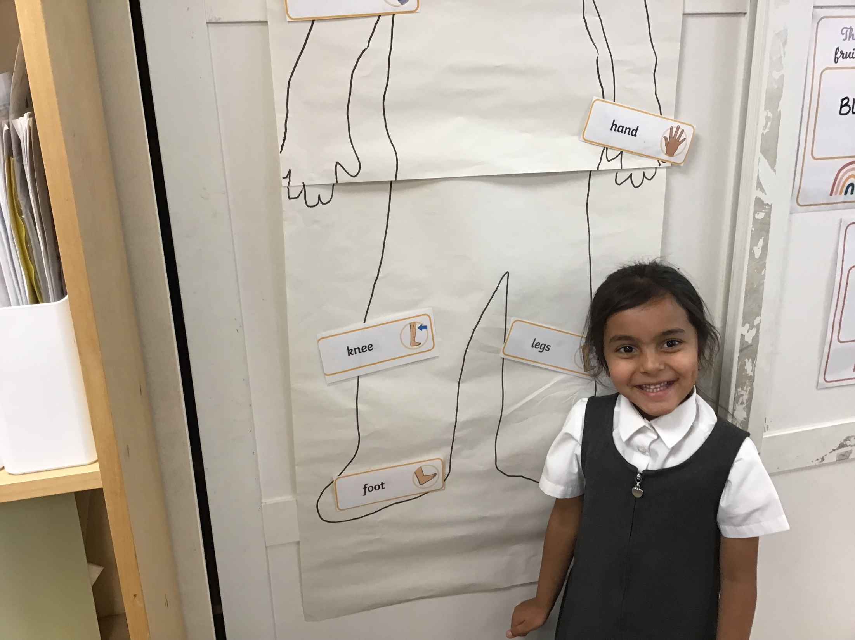
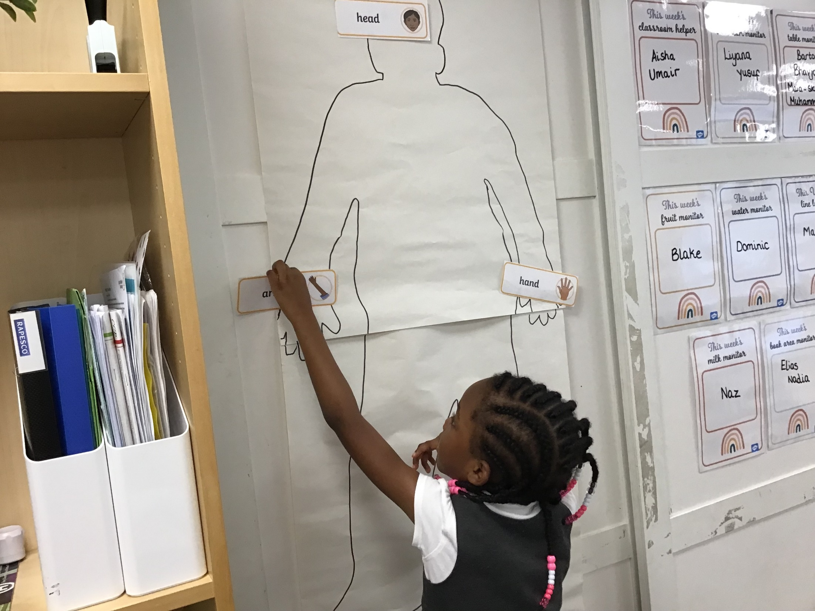
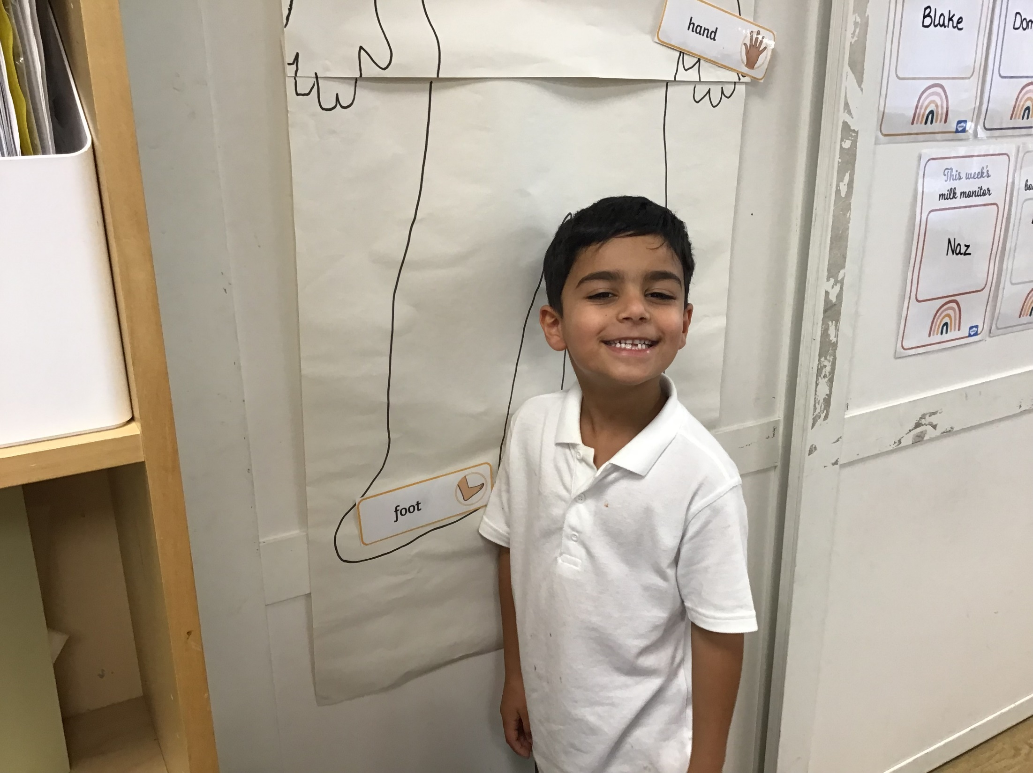
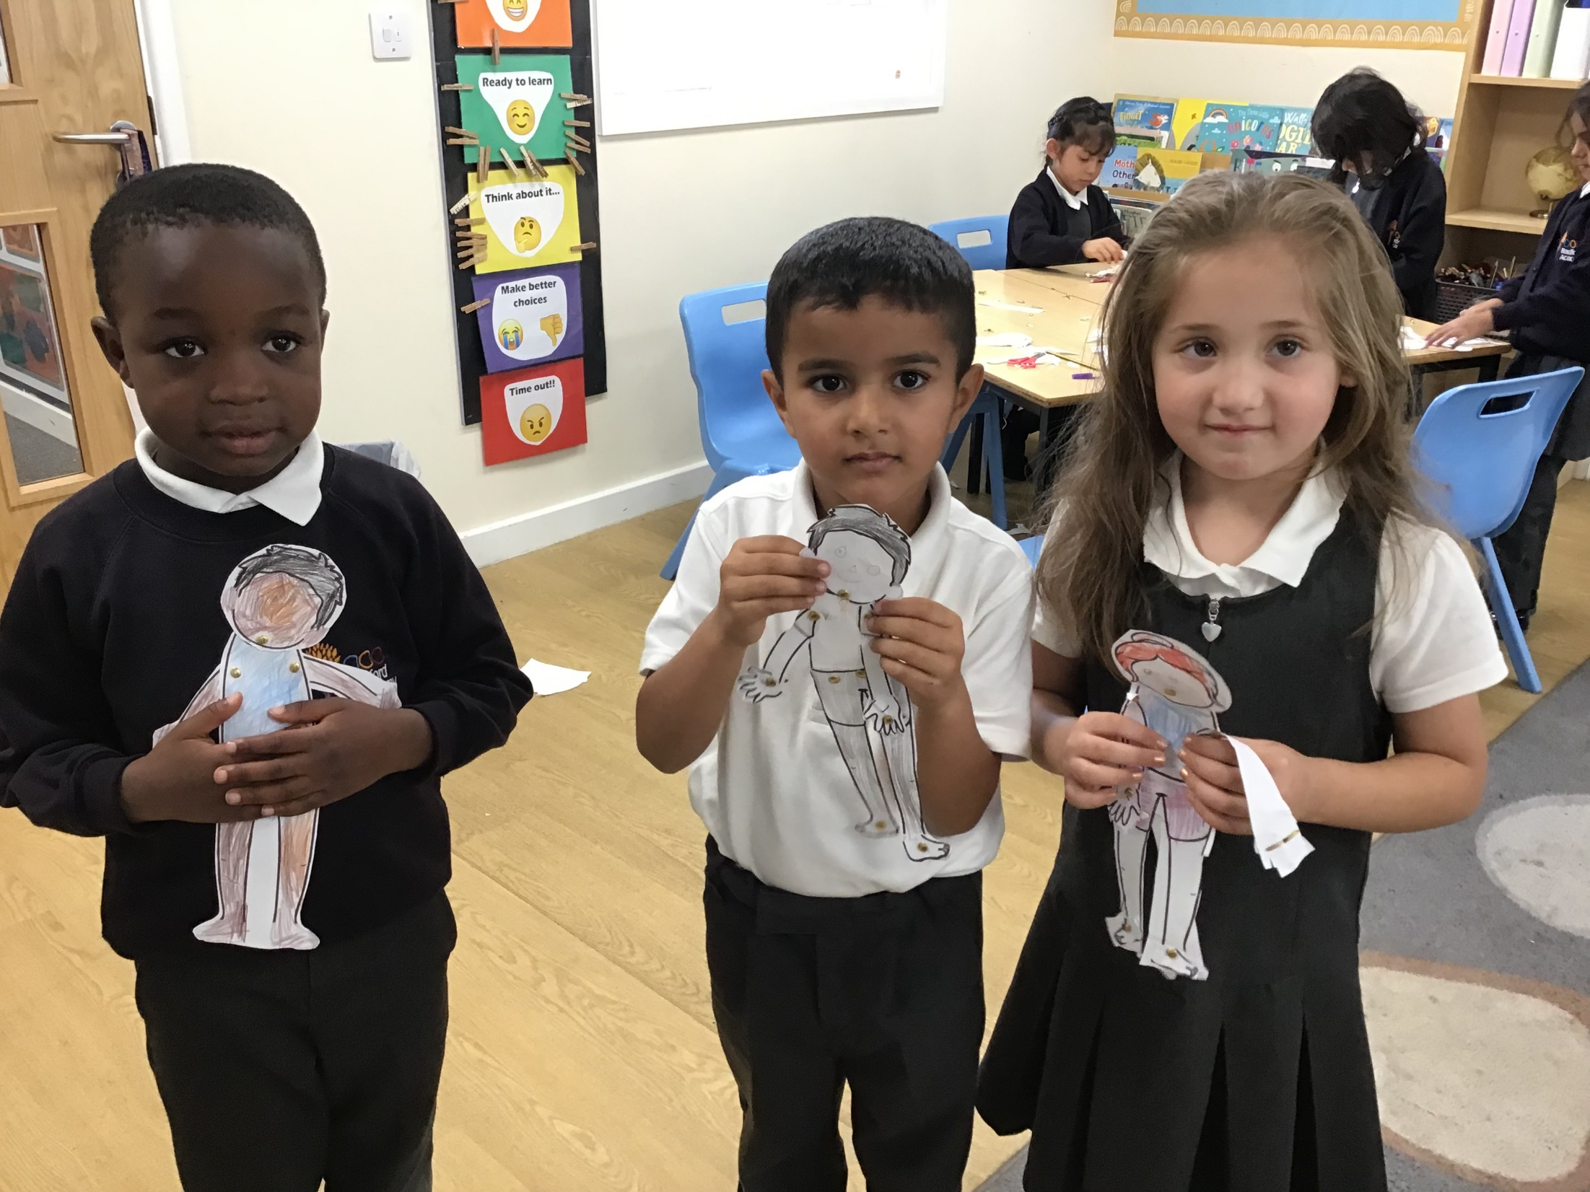
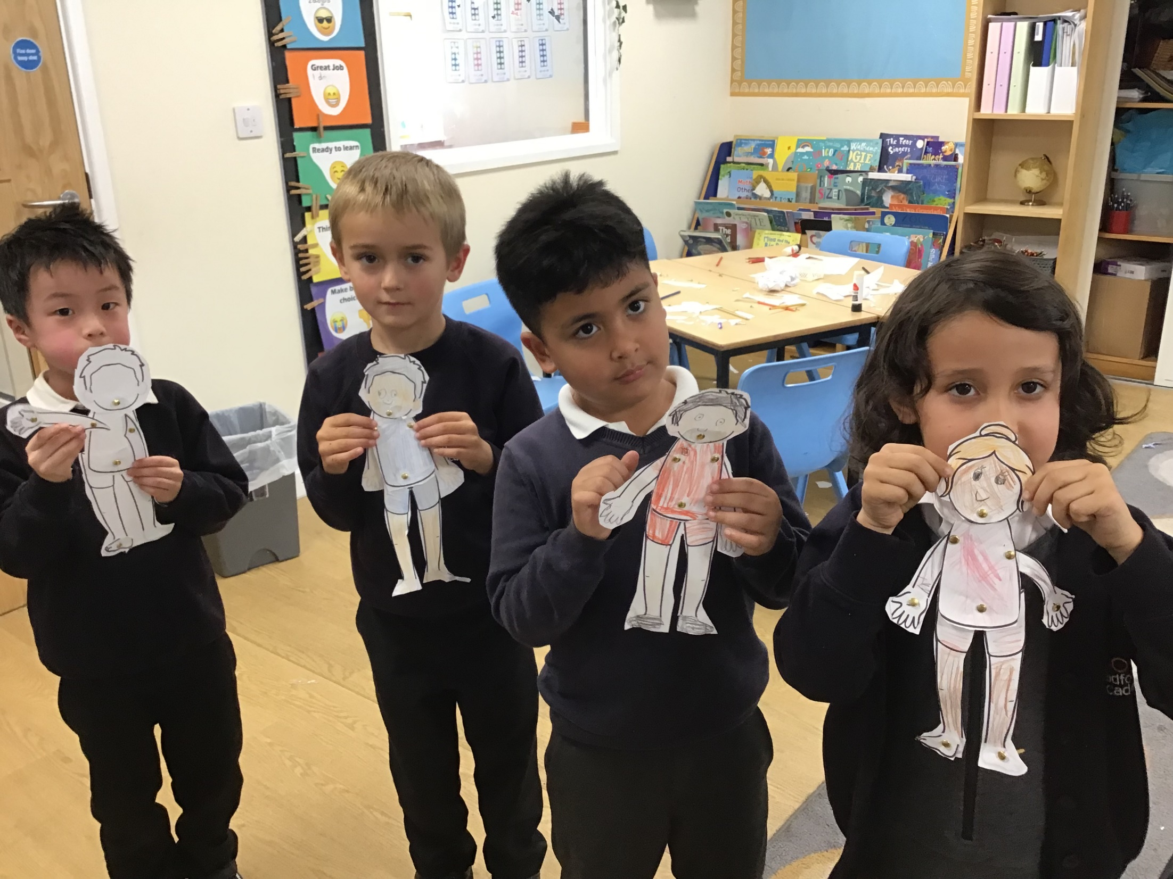
In science, class 1 were learning all about The Human Body – focusing on all the different body parts, their jobs and the five different senses. To conclude, they created their own moving body and explained what each body did.

Slide 6
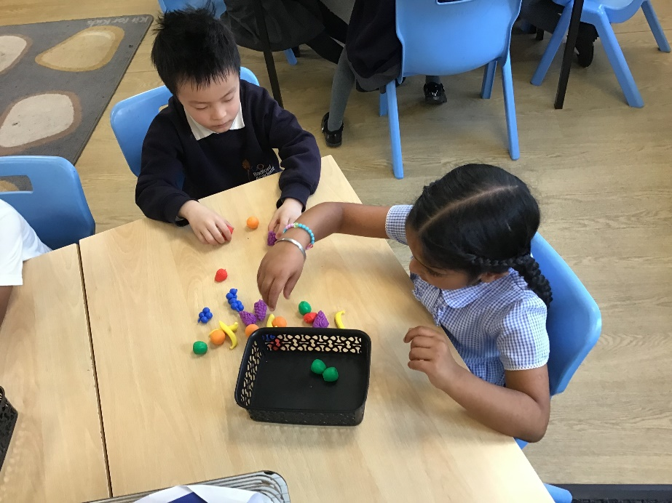
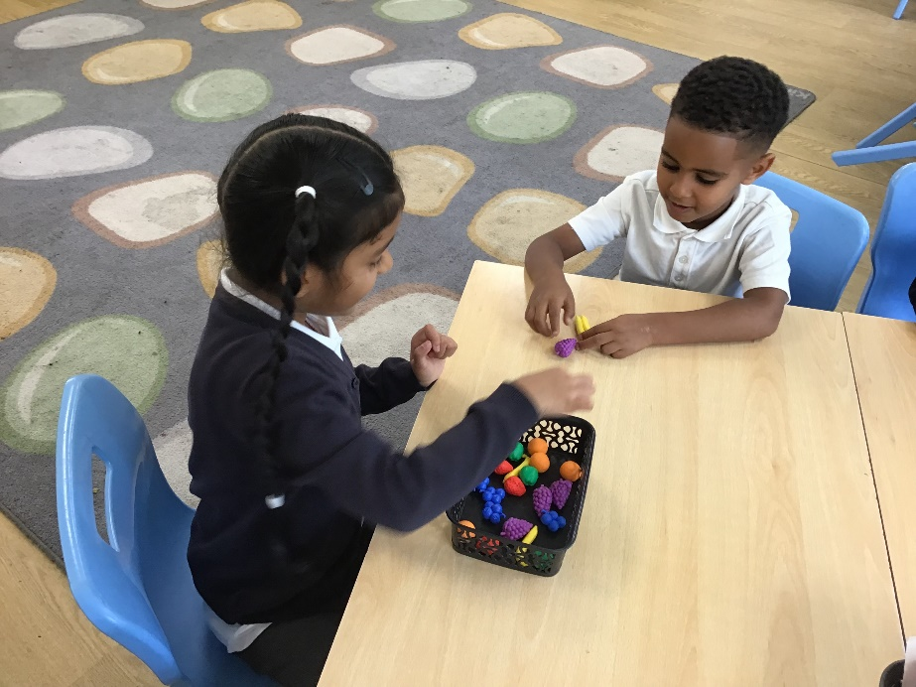
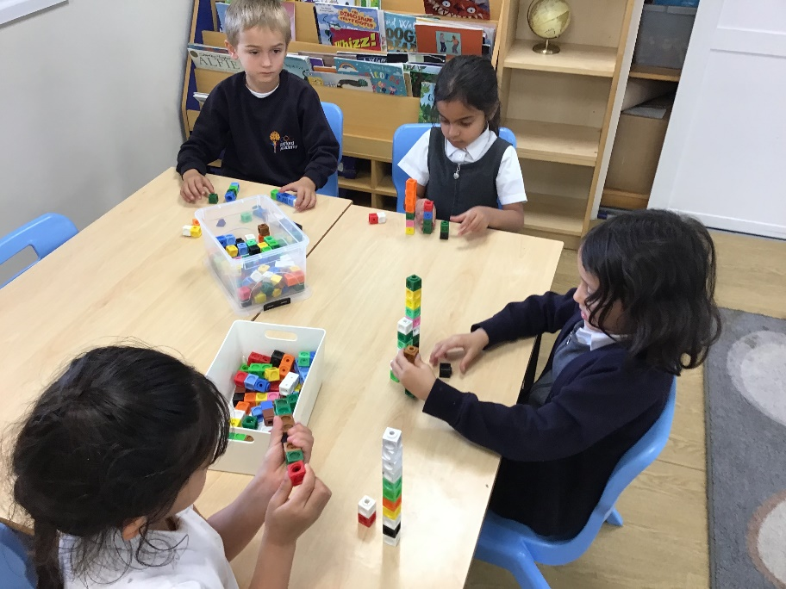
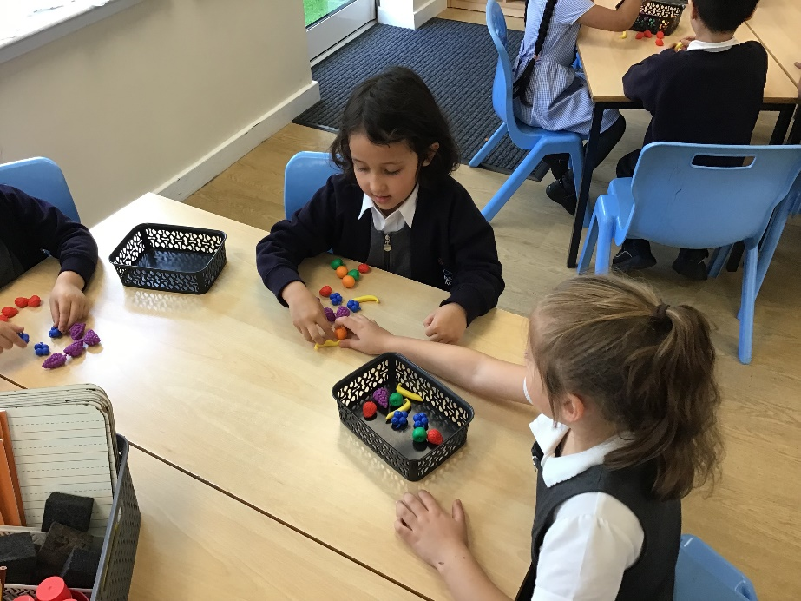
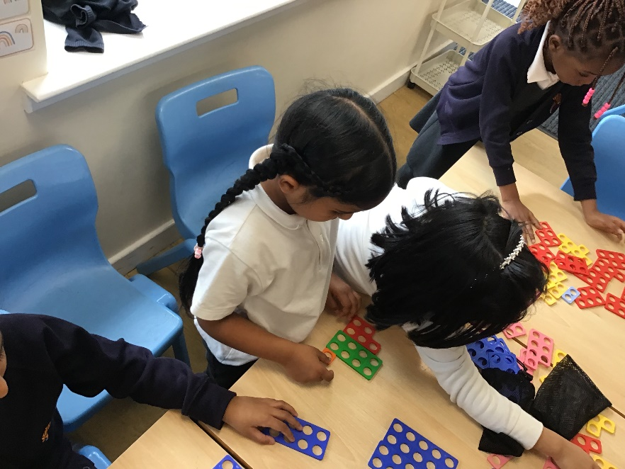
In maths, class 1 had a go at practically grouping objects in different ways i.e. size, colour or item. They also had a go at ordering numbers from biggest to smallest using different maths manipulatives.

