Slide 1

Radford Academy VE day celebrations
2024-2025

Slide 2
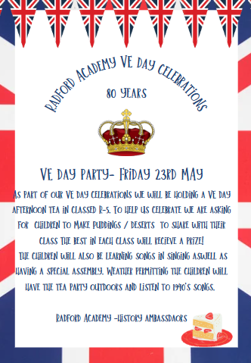
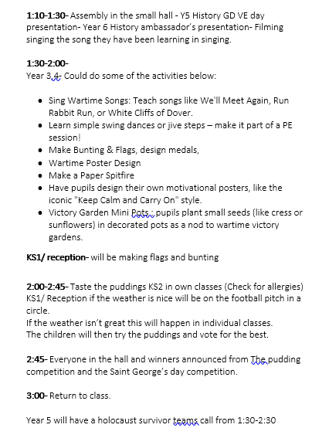

Slide 3
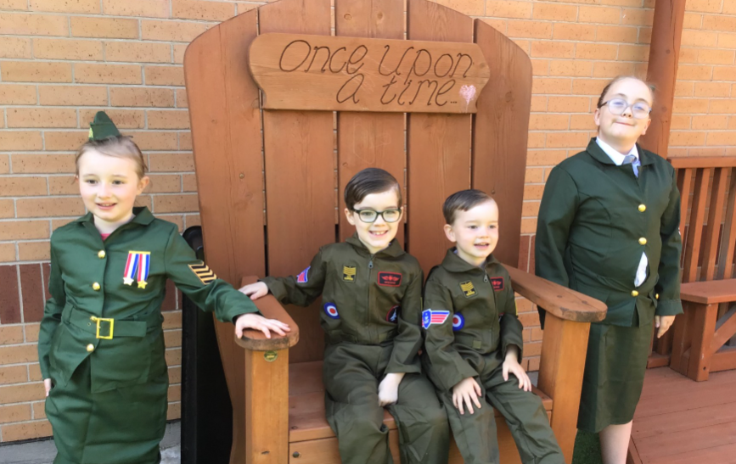

Slide 4
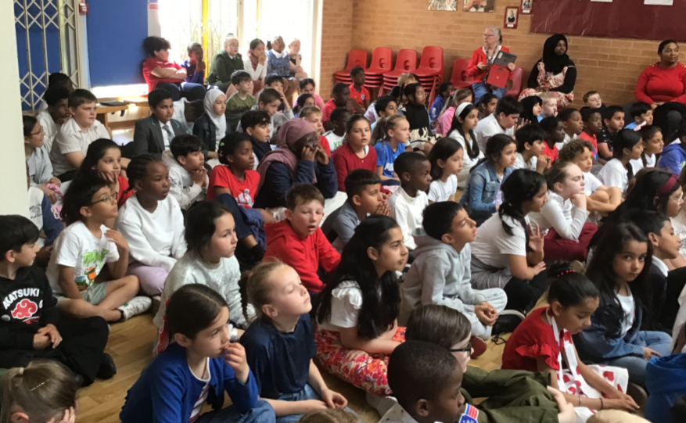

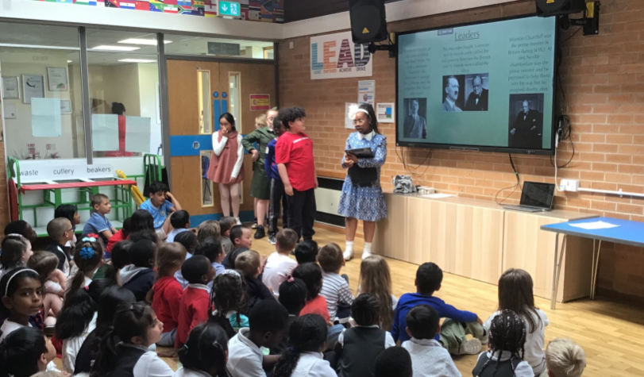
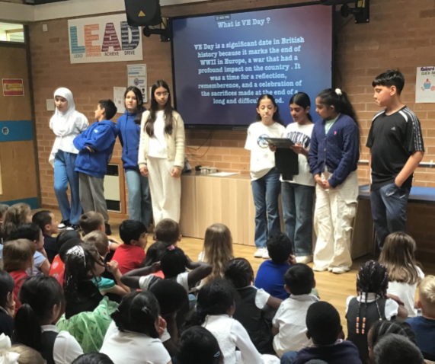
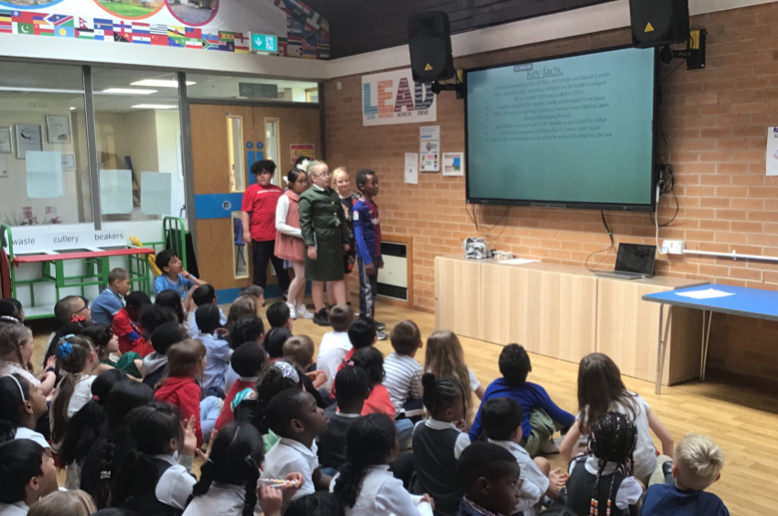
Assembly
The Year 6 History Ambassadors and the Year 5’s created a presentation all about VE day. They even tested the children’s knowledge by giving them a quiz. We also sang the song sing for the king.

Slide 5
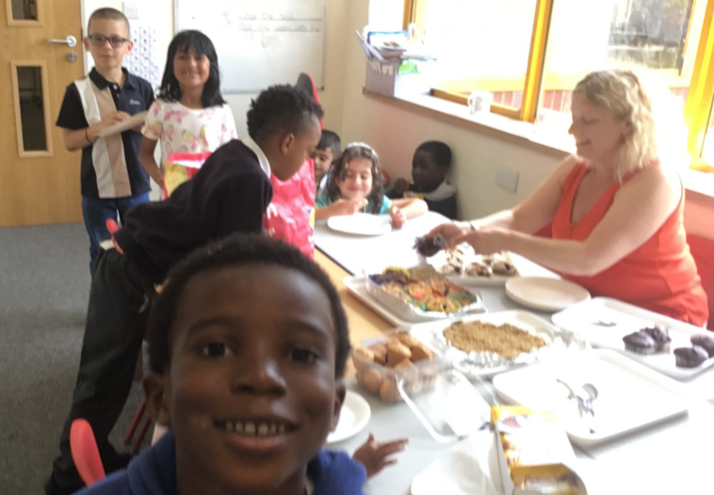
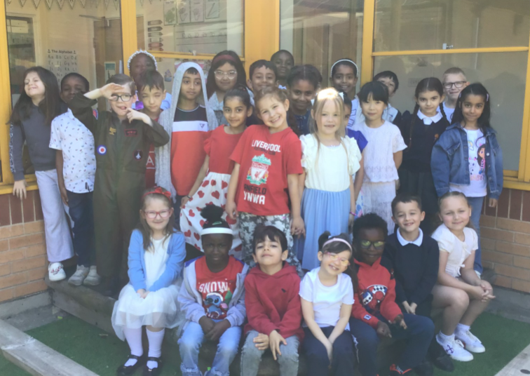
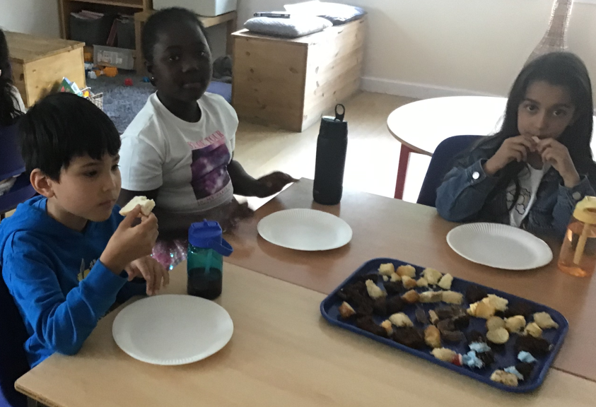
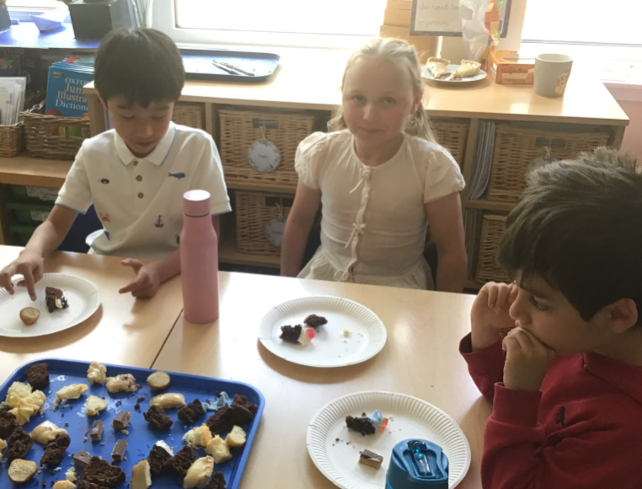
Reception and KS1
In Reception the children painted the Union jack flag. In Year 1 and Year 2 they decorated their own medal and drew pictures of VE day celebrations. They also made bunting for their tea party. In the afternoon they shared the puddings that they had made at home with their friends.

Slide 6
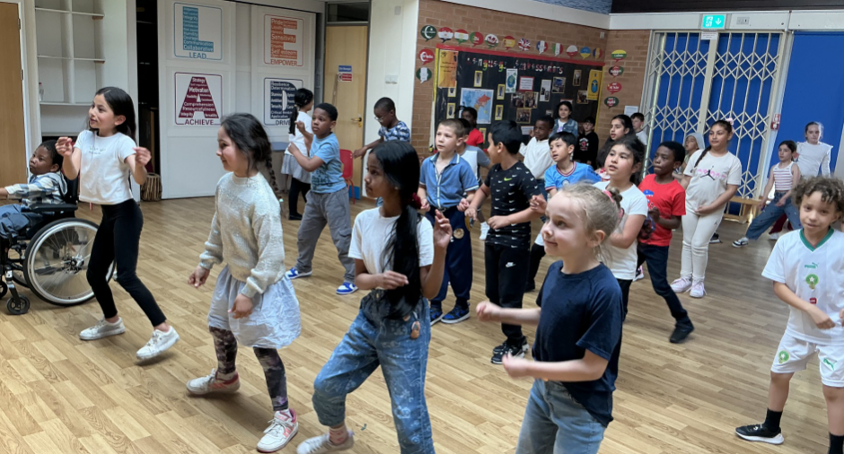
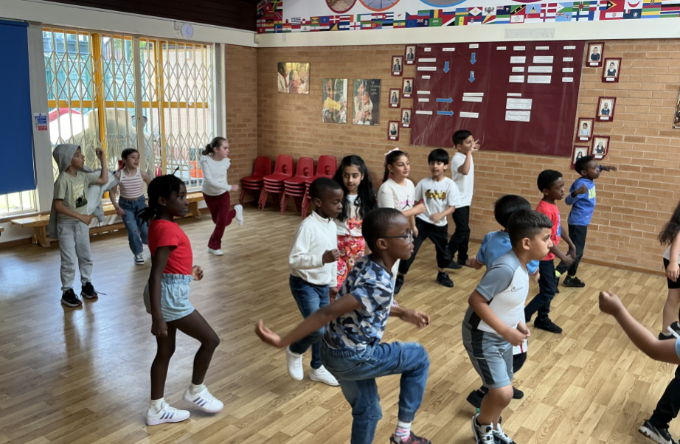
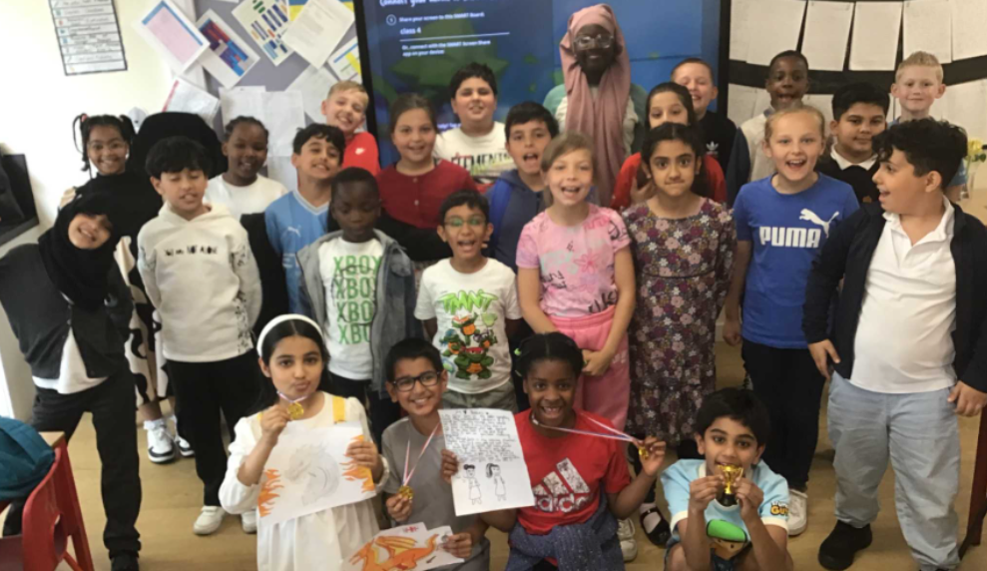
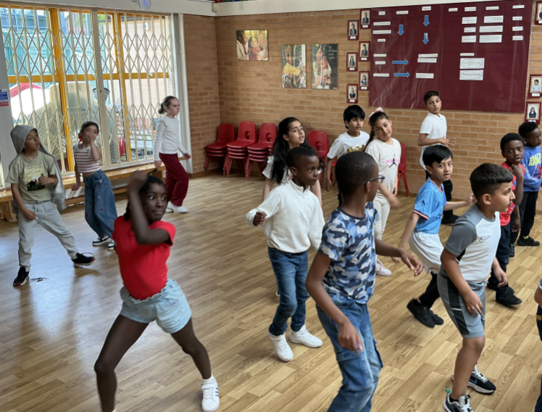
KS2
In year 3- they learned dhow to do the jive a popular dance around the time of WW2.
In year 4-They took part in art activities to celebrate VE day and pudding tasting.
In year 5- Had an online question and answer session with a holocaust survivor.

Slide 7
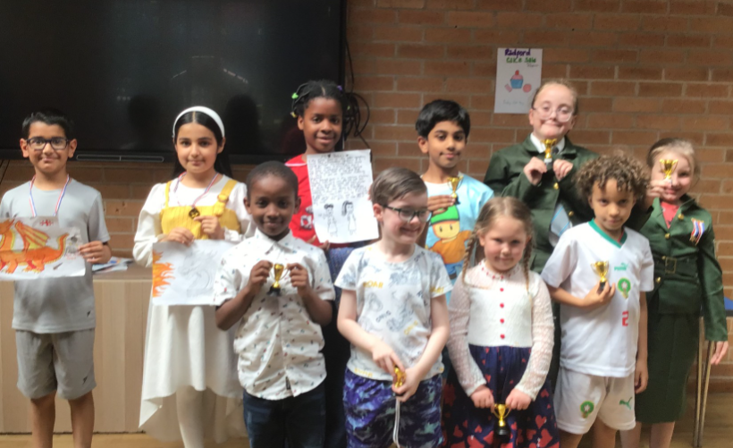
Our winners!
We announced our winners of the make your own Pudding competition.

